Slide 1
Ad Copywriting
DD Kullman – Instructor

Slide 2
Most Common Types of Message Appeals
Humor
Sex
Fear

Slide 3
Humor
Print ad campaign for Pro-Mark, a well known drumstick brand. By GSD&M Agency in Austin

Slide 4
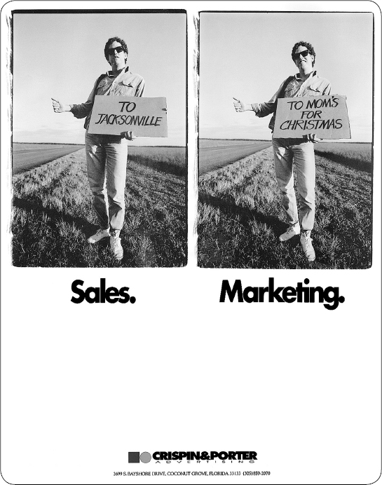
Humor
Print ad for Crispin & Porter ad agency in Miami

Slide 5
More Humor
30-foot-high billboard, north of the Twin Cities.
By Clarity Coverdale Fury ad agency.

Slide 6
Humor – Illustrated
Wrigley’s – “When we find bad breath, we kill it” campaign. By BBDO Chicago

Slide 7
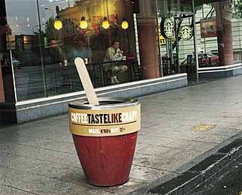
Humor in 3-D
“Coffee taste like crap?” garbage can outside of a Starbucks – encouraging viewers to try another coffee shop.

Slide 8
Hmmmn... Humor
Immodium Anti-Diarrhea medication ad. By Alchemy Agency, New York

Slide 9
Poking Fun… Humor
Croc’s “Ugly can be beautiful” campaign.
By TDA Advertising & Design, Boulder.

Slide 10
Oh No! Humor
Sauza Tequila Ad

Slide 11
Sex & Humor
Ad for Paris Hotel in Las Vegas, Nevada

Slide 12
Iconic Humor
Ad for Volkswagon Rabbit

Slide 13
Bigger than Life Humor
Outdoor advertising for Cingular cell phones

Slide 14
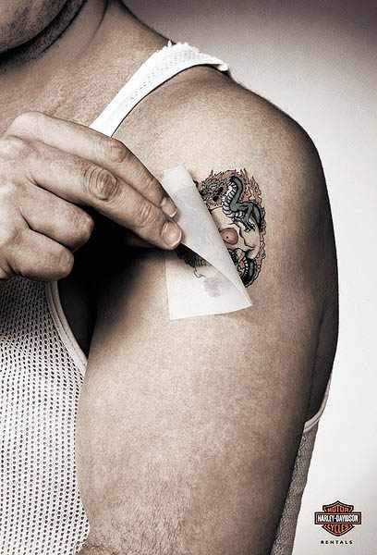
Harley Humor
Client: Harley Davidson Rentals

Slide 15
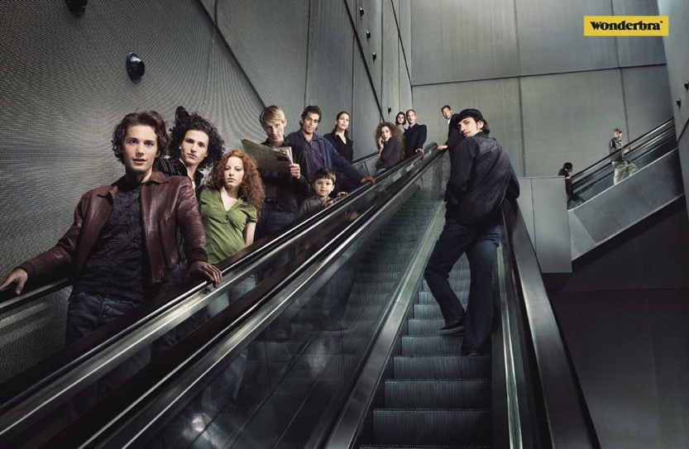
Sex
Wonderbra ad.
By Publicis Agency.

Slide 16
Implied Sex
Ad for Expedia.com by Ogilvy & Mather in London, UK

Slide 17
Implied Sex
Client: Aerobics First
Agency: Trampoline, Halifax

Slide 18
Art-Directed Sex
Ad for AIAIAI by AIAIAI Agency in Copenhagen, Denmark

Slide 19
Typographic Sex
Client: Activa Fitness Center
Agency: Y&R, Sao Paulo, Brazil
“Show your hidden beauty.”

Slide 20
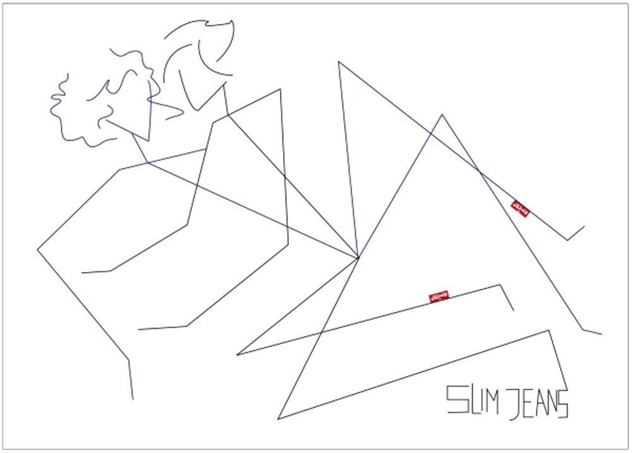
Sex - Illustrated

Slide 21
More Sex
LA Gear Shoes as a fashion accessory for women.
By David and Goliath Agency in LA

Slide 22
Vege-Sex
Client: PETA
Agency: PETA
Sexy NBA scout Bonnie-Jill Laflin bares her body in a sizzling ad for PETA to show how hot a vegetarian diet can be.

Slide 23
More Realistic Sex
Nike’s depictions of “real women.”
By Wieden+Kennedy, Portland

Slide 24
Fear
Ad for American Society for the Prevention of Cruelty to Animals.
By Saatchi & Saatchi, NY

Slide 25
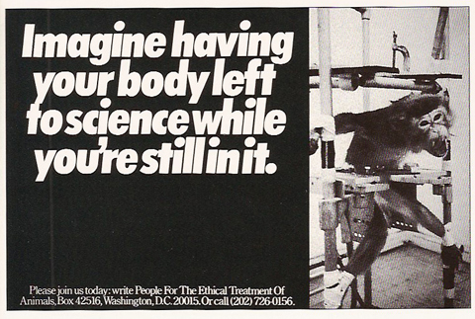
Fear
Ad for the People for the Ethical Treatment of Animals.

Slide 26
Fear
Ad for The Children’s Defense Fund.

Slide 27
Latent Fear
For Boy Scouts of America.
By Hill Holliday – Boston

Slide 28
In your face Fear

Slide 29
What do these ads have in common?
Where’s the copy?

Slide 30
Copywriting is more than just putting pen to paper. It’s the concept that counts.

Slide 31
Copywriting is Salesmanship in Print.
Concept + Persuasion = Good Copy

Slide 32
Examples You’ve Seen?
What ads come to mind?

